Slide 1
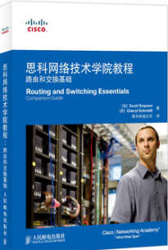

课程介绍
刘峰
fengliu@nju.edu.cn
主要参考资料
思科网络技术学院教程
网络简介
路由和交换基础
计算机网络
谢希仁 第六版、第七版

Slide 2
课程考核
考试
英文试题
内容
上机
拓扑实现
模拟器练习 packet tracer

Slide 3
Computer Network & Network Reference Model

Slide 4
Computer Network & Network Reference Model
Overview of Computer Network
OSI Reference Model
TCP/IP Model
Network Topology
Network Devices
Notes:
新技术条件：强烈的社会需求；前期技术的成熟。
数据通信技术的研究与应用；
ARPAnet与分组交换技术的应用；
ISO与TCP/IP协议的研究与发展；
Internet的广泛应用。

Slide 5
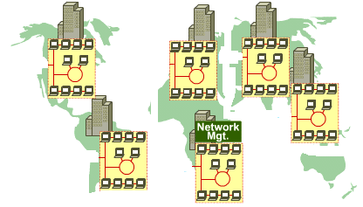
Networks
What is a network ?
A network is an intricately connected system of objects, devices, or people
Companies created networks
As companies expanded, the need for connecting networks at different sites became very important
Notes:
广义观点：以传输信息为目的，用通信线路将多个计算机连接起来的计算机系统的集合。雏形，共享能力弱。
资源共享观点：以能够相互共享资源方式互联的自治计算机系统的集合。共同网络协议。最适合的定义。
1）至少有两台及以上具有独立操作系统的计算机，且它们之间有相互共享某种资源的需求。
2）独立的计算机之间必须用某种通信手段连接。
3）必须有相互确认的规范标准或协议以保证通信可行可靠

Slide 6
Data Networks Classifications
LAN( Local Area Networks )
WAN( Wide Area Networks )
Node
Link
Notes:
网络可以被抽象成两种基本构件：结点和链路
传输技术：广播和点对点；
城域网MAN
历史：先有WAN，发展出来LAN

Slide 7
LAN/WAN
Local Area Networks (LANs)
Operate locally (cover small areas)
Multi-user access
High speeds expected (up to Gbps/10Gbps)
Error rate is easily controlled
Wide Area Networks (WANs)
Operate over larger areas
Access over serial links, optical links, etc.
Traditionally, have Lower speeds
Error rate can not be easily controlled
Notes:
LAN：10G，几公里
WAN：几十公里到几千公里，分组交换

Slide 8




LAN Devices
Multiport repeater, connects PCs; Repeats signals
LAN segmentation; MAC addresses.
Hub
Bridge
Switch
Multiport-bridge; Full bandwidth
Router
Path determination; Packet switching

Slide 9
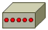
WAN Devices
Path determination; Packet switching
Router
Modem
CSU/DSU
TA/NT1
Analog to Digital;
Remote LAN connections
Notes:
CSU：Channel Service Unit，通道服务单元。把终端用户和本地数字电话环路相连的数字接口设备。
DSU：Data Service Unit，数据服务单元。指的是用于数字传输中的一种设备，它能够把DTE设备上的物理层接口适配到T1或者E1等通信设施上。
信道服务单元／数字服务单元（ CSU/DSU ）是 T1/E1 服务的接口，
终端适配器／网络终结器（ TA/NT1 ）是综合业务数字网（ ISDN ）的接口

Slide 10
LAN Services and WAN Services
LAN service: Ethernet, the most popular service
WAN services...
Modem
ISDN
DSL
Frame Relay
ATM
T1/E1
T3
STS-1, STS-3, STS-48 (SONET/SDH)
Notes:
ISDN：Integrated Services Digital Network，综合业务数字网，以电话综合数字网为基础发展成的通信网，能提供端到端的数字连接，用来承载包括话音和非话音在内的多种电信业务
DSL：Digital Subscriber Line，数字用户线路，以铜电话线为传输介质的点对点传输技术
ATM：Asynchronous Transfer Mode，异步传输模式具有分组交换和电路交换的优点，对应于OSI协议参考模型的第2层。ATM通过AAL层适配，将不同业务应用接纳进来；
帧中继（ Frame Relay）是一种用于连接计算机系统的面向分组的通信方法。它主要用在公共或专用网上的局域网互联以及广域网连接。大多数公共电信局都提供帧中继服务，把它作为建立高性能的虚拟广域连接的一种途径
T1&E1技术 TDM技术（ Time Division Multiplexing，时分复用）在数字通信系统中逐渐得到广泛的应用后，目前，在数字通信系统中存在两种时分复用系统，一种是 ITU-T 推荐的 E1 系统，一种是由 ANSI 的 T1 系统。 1.5M，44M（T3) SONET：synchronous optical network;SONET ，同步光网络，美国的光传送网标准
SDH，Synchronous Digital Hierarchy，同步数字体系，SONET应用在美国和加拿大，SDH应用在世界其他国家

Slide 11
Internet
internet:
A network whose nodes are networks
Internet
The largest, open, interconnected computer network in the world.
TCP/IP is the reference model of Internet
Evolved from ARPANET
Internet
Notes:
冷战 1957 苏联 人造卫星 advanced research projects agency
1969.11正式启用，当时仅连接了4个节点（哈弗、加州。斯坦福、犹他），供科学家们进行计算机联网实验用。
到1975,100台主机，交给DOD正式运行；
到70年代，ARPAnet已经有了好几十个计算机网络，但是每个网络只能在网络内部的计算机 之间互联通信，不同计算机网络之间仍然不能互通。为此， ARPA又设立了新的研究项目，支持学术界和工业界进行有关的研究。研究的主要内容就是想用一种新的方法将不同的计算机局域网互联，形成“互联网”。研究人员称之为“internetwork”，简称“Internet”。这个名词就一直沿用到现在
1980，ARPAnet开始TCP/IP，1983.1转换结束；分出MILnet军方非机密通信，NSFnet（国家科学基金会网络）1990，ARPAnet退役
Internet的发展引起了商家的极大兴趣。1992年，美国IBM、MCI、MERIT三 家公司联合组建了一个高级网络服务公司（ANS），建立了一个新的网络，叫做ANSnet，成为Internet的另一个主干网。它与NSFnet不 同，NSFnet是由国家出资建立的，而ANSnet则是ANS 公司所有，从而使Internet开始走向商业化。
1974TCP、1982WWW、1983Mosaic、1984PPP

Slide 12
Internet with Multi-layer ISP structure
Internet Service Providers (ISP)
User
ISP
ISP₁
Internet
ISP₂
Notes:
个人、校园网-》ISP-》地区网-》主干网：通过高速通信线路与其他主干网相连。

Slide 13
本地 ISP
第三层
本地 ISP
本地 ISP
第二层
第二层 ISP
本地 ISP
第一层
大公司
本地 ISP
大公司
本地 ISP
第一层 ISP
第一层 ISP
第二层 ISP
本地 ISP
本地 ISP
第二层 ISP
NAP
一级 ISP
NAP
一级 ISP
第一层 ISP
第二层 ISP
本地 ISP
本地 ISP
第二层 ISP
第二层 ISP
大公司
本地 ISP
本地 ISP
本地 ISP
本地 ISP
公司
A
B
校园网
校园网
校园网
校园网
主机A → 本地 ISP → 第二层 ISP → NAP → 第一层 ISP → NAP → 第二层 ISP → 本地 ISP → 主机B
Internet with Multi-layer ISP structure
Notes:
ISP：Internet Service Provider，电信运营商
ICP：Internet Content Provider，新浪、搜狐
NAP：Network Access Point，通达因特网主干线的点；ISP互相连接的点。NAP可用作主要业务提供者的数据互换点。
复杂的功能在终端

Slide 14
Data
Data is sent in bits, 1s and 0s.
Data is not the information itself
Data is an encoded form of information which is a series of electrical impulses/optical signals into which information is transmitted for sending
Notes:
数据是二进制序列的表示；信息是其所表示意义的解释；信号是传输过程中电信号的表示形式。

Slide 15
Data Packets
For transmission, computer data is often broken into small, easily transmitted units
Using the OSI model, these units can be called packets, or frames or segments
Why data packets?
Computers can take turns sending packets
If packet is lost, only small amount of data must be retransmitted.
Data can take different paths.

Slide 16
Protocol
It is possible for different types of computer systems to communicate
All devices must speak the same “language” or use the same protocol (use same set of rules).
Notes:
邮政系统：信件内容、格式、邮局处理方式。邮政编码内容 ；看电影的例子
语义定义了做什么；语法定义怎么做；时序关系定义了什么时候做。
协议定义消息传输和传递的详细方式。包括以下方面：
消息格式
时间
封装
编码

Slide 17
Source and Destination
Source address specifies the identity of the computer sending the packet.
Destination address specifies the identity of the computer designated to receive the packet.

Slide 18
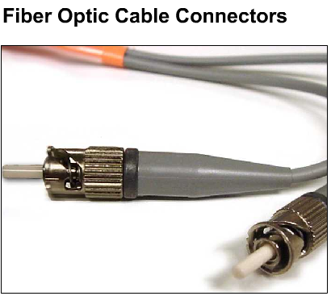
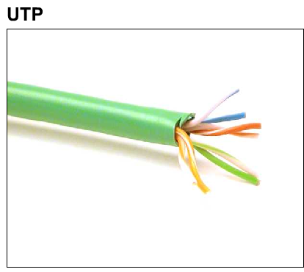
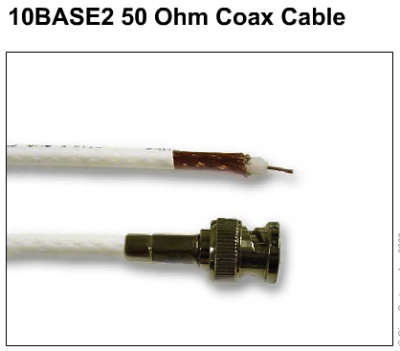
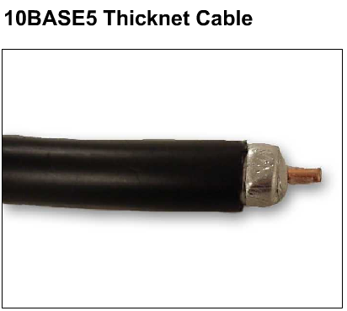
Media Types
AIR
carries light, radio, microwave
Media—material through which data packets travel

Slide 19
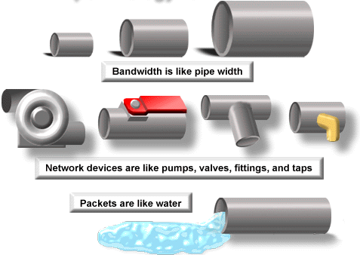
Digital Bandwidth
Bandwidth is the measure of how much information can flow from one place to another in a given amount of time.
Measured in: bits/second (bps)

Slide 20
Throughput
Actual, measured, bandwidth, at a specific time
Throughput ≤ Bandwidth

Slide 21
Computer Network & Network Reference Model
Overview of Computer Network
OSI Reference Model
TCP/IP Model
Network Topology
Network Devices

Slide 22
OSI (Open System Interconnection) Model
Proposed by International Organization for Standardization (ISO)
A network model that help network builders implement networks that could communicate and work together
Describes how information or data moves from one computer through a network to another computer
a layered communication process
Each layer performs a specific task

Slide 23
The OSI Reference Model
Each layer has a unique function.
User interface
Data presentation and encryption
Inter-host connection
End-to-end connections
Addresses and best path
Access to media
Binary transmission
7
6
5
4
3
2
1
Application
Presentation
Session
Transport
Network
Data Link
Physical

Slide 24
Why a Layered Model?
Reduce Complexity
Standardizes interfaces
Facilitates modular engineering
Ensures interoperable technology
Accelerates evolution
Simplifies teaching and learning
Notes:
Layer处理复杂问题的基本方法
大的功能分配；不同地区的系统相同的层次；高层不需要知道底层的具体实现。

Slide 25
The OSI Reference Model
Application
Presentation
Session
The top 3 layers are known as the application layers
because they deal with the user interface, data formatting, and the application access.

Slide 26
The OSI Reference Model
4
3
2
1
Transport
Network
Data Link
Physical
Layers 1-4 are known as the data flow layers
because they control the physical delivery of messages over the network.

Slide 27
Layer 1: The Physical Layer
Keywords: Signal and Media
User interface
Data presentation and encryption
Inter-host connection
End-to-end connections
Addresses and best path
Access to media
Binary transmission
7
6
5
4
3
2
1
Application
Presentation
Session
Transport
Network
Data Link
Physical
Application
Presentation
Session
Transport
Network
Data Link
Physical

Slide 28
Layer 1: The Physical Layer
defines the electrical and functional specifications for the link between end systems (including media)
defines voltage levels, timing of voltage changes, physical data rates, maximum transmission distances, physical connectors, and other, similar attributes

Slide 29
Layer 2: The Data Link Layer
Keywords: frame, media access control
Application
Presentation
Session
Transport
Network
Data Link
Physical
User interface
Data presentation and encryption
Inter-host connection
End-to-end connections
Addresses and best path
Access to media
Binary transmission
7
6
5
4
3
2
1
Application
Presentation
Session
Transport
Network
Data Link
Physical

Slide 30
Layer 2: The Data Link Layer
provides reliable transit of data across a physical link
is concerned with physical (as opposed to logical) addressing, network topology, network access, error notification, ordered delivery of frames, and flow control

Slide 31
Layer 3: The Network Layer
Keywords: Path selection, Routing, Addressing
User interface
Data presentation and encryption
Inter-host connection
End-to-end connections
Addresses and best path
Access to media
Binary transmission
7
6
5
4
3
2
1
Application
Presentation
Session
Transport
Network
Data Link
Physical
Application
Presentation
Session
Transport
Network
Data Link
Physical

Slide 32
Layer 3: The Network Layer
Provide connectivity and path selection between two end systems where routing occurs
These may be located on geographically separated networks

Slide 33
Layer 4: The Transport Layer
Keywords: Reliability, Flow control, Error correction
Application
Presentation
Session
Transport
Network
Data Link
Physical
User interface
Data presentation and encryption
Inter-host connection
End-to-end connections
Addresses and best path
Access to media
Binary transmission
7
6
5
4
3
2
1
Application
Presentation
Session
Transport
Network
Data Link
Physical

Slide 34
Layer 4: The Transport Layer
segments and reassembles data into a data stream
concerned with how reliable transport over an internetwork is accomplished
responsible for reliable network communication between end nodes and provides mechanisms for the establishment, maintenance, and termination of virtual circuits, transport fault detection and recovery, and information flow control

Slide 35
Layer 5: The Session Layer
Keywords: Dialog and Conversations
Application
Presentation
Session
Transport
Network
Data Link
Physical
User interface
Data presentation and encryption
Inter-host connection
End-to-end connections
Addresses and best path
Access to media
Binary transmission
7
6
5
4
3
2
1
Application
Presentation
Session
Transport
Network
Data Link
Physical

Slide 36
Layer 5: The Session Layer
establishes, manages, and terminates sessions between communicating hosts
synchronizes dialog between presentation layer entities and manages their data exchange
offers provisions for efficient data transfer, class of service, and exception reporting of session, presentation, and application layer problems
manages data exchange between presentation layer entities

Slide 37
Layer6: The Presentation Layer
Keywords: Common Format
User interface
Data presentation and encryption
Inter-host connection
End-to-end connections
Addresses and best path
Access to media
Binary transmission
7
6
5
4
3
2
1
Application
Presentation
Session
Transport
Network
Data Link
Physical
Application
Presentation
Session
Transport
Network
Data Link
Physical

Slide 38
Layer6: The Presentation Layer
ensures that information sent by the application layer of one system is readable by the application layer of another system
translates between multiple data representation formats by using a common data representation format
concerned with data structures and negotiation of data transfer syntax
responsible for compression and encryption

Slide 39
Layer 7: The Application Layer
Keyword: Browser
Application
Presentation
Session
Transport
Network
Data Link
Physical
User interface
Data presentation and encryption
Inter-host connection
End-to-end connections
Addresses and best path
Access to media
Binary transmission
7
6
5
4
3
2
1
Application
Presentation
Session
Transport
Network
Data Link
Physical

Slide 40
Layer 7: The Application Layer
closest to the user
provides network services to user applications
does not provide services to any other OSI layer

Slide 41
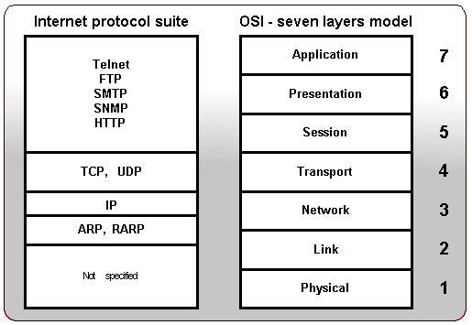
Protocols on ISO layers

Slide 42
Data Encapsulation
计算机 1
计算机 2
AP₁
应 用 程 序 数 据
AP₂
首部
5
H5
数 据 部 分
5
TCP报文段
UDP报文段
4
H4
数 据 部 分
4
IP数据报
IP分组
3
H3
数 据 部 分
3
尾部
帧
2
H₂
数 据 部 分
T₂
2
比特
1
10100110100101 比 特 流 10100110100101
1
物 理 传 输 媒 体
Notes:
往往采取折中的办法，即综合 OSI 和 TCP/IP 的优点，采用一种只有五层协议的体系结构
同一系统相邻两层的实体进行交互的地方，称为服务访问点 SAP (Service Access Point)

Slide 43
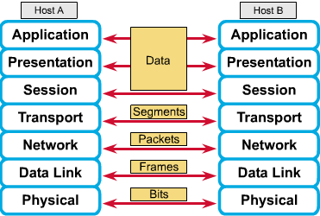
Peer-to-Peer Communications
Notes:
经理-秘书-收发室-快递-中转（合同）

Slide 44
Computer Network & Network Reference Model
Overview of Computer Network
OSI Reference Model
TCP/IP Model
Network Topology
Network Devices
Notes:
1957：苏联人造卫星->ADPA（Advanced Research Projects Agency）
分时计算机，联网流量“突发性”
1967：ADPAnet：第一个分组交换机；
1969:4个节点的计算机网络4所高校
1972:15个结点，对公演示
1973年故障，15个接口报文处理机、百台主机、2000个用户->互联体系TCPIP->1978TCP与IP分开

Slide 45

The TCP/IP Model
The U.S. Department of Defense (DoD) created the TCP/IP reference model
The DoD wants its packets to get through every time, under any conditions, from any one point to any other point.
It brought about the creation of the TCP/IP model
TCP/IP model has since become the standard on which the Internet has grown
Notes:
因特网发展三个阶段
1、60年代到80年代初 1983 年 TCP/IP 协议成为标准协议
2、1986 年，NSF 建立了国家科学基金网。 NSFNET；1991 年，美国政府决定将因特网的主干网转交给私人公司来经营，并开始对接入因特网的单位收费
3、从1993年开始，由美国政府资助的 NSFNET逐渐被若干个商用的 ISP 网络所代替；1994 年开始创建了 4 个网络接入点 NAP (Network Access Point)，分别由 4 个电信公司经营；从 1994 年到现在，因特网逐渐演变成多级结构网络

Slide 46

The TCP/IP Model
The TCP/IP model has only four layers.
Application
Transport
Internet
Network Access

Slide 47
The TCP/IP Model - Application Layer
Handles high-level protocols, issues of representation, encoding, and session control
TCP/IP combines all application-related issues into one layer, and assures this data is properly packaged for the next layer.

Slide 48
The TCP/IP Model - Transport Layer
Deals with the quality-of-service issues of reliability, flow control, and error correction.
Transmission Control Protocol (TCP)
User Datagram Protocol(UDP)
It package application layer information into units called segments

Slide 49
The TCP/IP Model - Internet Layer
Purpose: Send source packets from any network on the internetwork and have them arrive at the destination independent of the path and networks
Best path determination and packet switching occur at this layer
Internet protocol (IP)

Slide 50
The TCP/IP Model – Network Access Layer
Is also called the host-to-network layer.
It is concerned with all of the issues that an IP packet requires to actually make a physical link, and then to make another physical link.
It includes the LAN and WAN technology details, and all the details in the OSI physical and data link layers.

Slide 51
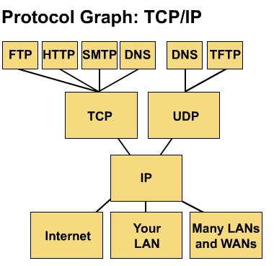
Common TCP/IP Protocols
Application Layer
Transport Layer
Internet Layer
Network Access Layer

Slide 52
Common TCP/IP Protocols
FTP - File Transfer Protocol
HTTP - Hypertext Transfer Protocol
SMTP - Simple Mail Transfer protocol
DNS - Domain Name System
TFTP - Trivial File Transfer Protocol

Slide 53
Similarities of TCP/IP and OSI
Application
Transport
Internet
Network Access
Application
Presentation
Session
Transport
Network
Data Link
Physical
both have layers, networking professionals need to know both
both have application layers, though they include very different services
both have comparable transport and network layers
packet-switched (not circuit-switched) technology is assumed

Slide 54
Differences of TCP/IP and OSI
Application
Transport
Internet
Network Access
Application
Presentation
Session
Transport
Network
Data Link
Physical
TCP/IP appears simpler because it has fewer layers
TCP/IP protocols are the standards around which the Internet developed, so the TCP/IP model gains credibility just because of its protocols.
Typically networks aren't built on the OSI protocol, even though the OSI model is used as a guide.

Slide 55
Computer Network & Network Reference Model
Overview of Computer Network
OSI Reference Model
TCP/IP Model
Network Topology
Network Devices
Notes:
保证一定的网络相应时间、吞吐量和可靠性的条件下，选择适当的线路、线路容量与连接方式，使得整个网络结构合理且成本低廉。

Slide 56
Topology
Defines the structure of the network
Physical topology: the actual layout of the wire (media)
bus, star, ring, extended star, hierarchical, mesh
Logical topology: defines how the media is accessed by the hosts
token passing
Notes:
拓扑设计是第一步，也是实现各种网络协议的基础
由图论演变而来，研究点线面之间的线路抽象。
广播信道、点对点信道：树、环

Slide 57
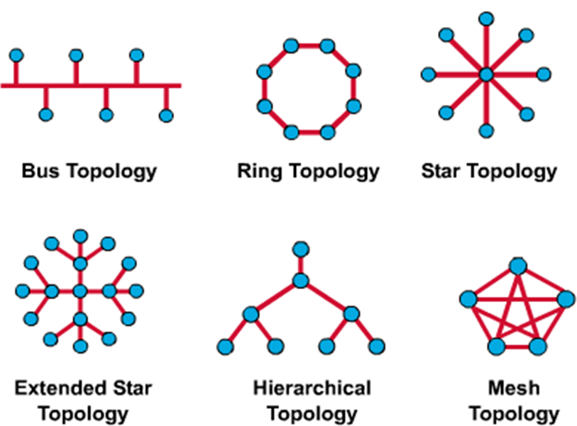
Network Topologies

Slide 58
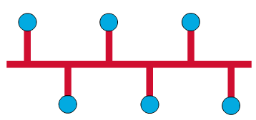
Network Topologies--Bus
Physical Perspective Each host is wired to a common wire.
Advantage: all hosts can communicate directly.
Disadvantage: A break in the cable disconnects hosts from each other.
Logical Perspective
Every networking device to see all signals from all other devices (advantage?)
Notes:
介质访问控制方法：
哪个结点发送数据、会不会冲突、冲突后怎么办？
结构简单、实现容易、易于扩展、可靠性好

Slide 59
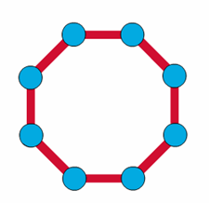
Network Topologies--Ring
Physical Perspective
All devices wired directly to each other in what is called a daisy-chain.
Logical Perspective
In order for information to flow, each station must pass the information to its adjacent station.
Notes:
结点通过网卡点点连接，构成闭合的环、数据沿着一个方向

Slide 60
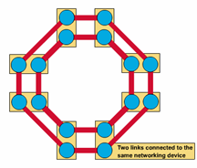
Network Topologies — Dual Ring
Physical Perspective
A dual ring topology is the same as a ring topology, except that there is a second, redundant ring, that connects the same devices.
Advantages: provide reliability and flexibility
Logical Perspective
A dual ring topology acts like two independent rings, of which, only one at a time is used.

Slide 61

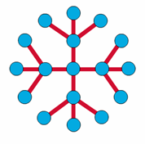
Network Topologies—Star
Physical Perspective A star topology has a central node with all links radiating from it.
Advantage: it allows all other nodes to communicate with each other, conveniently. It also might be desirable for security or restricted access reasons
disadvantage: if the central node fails, the whole network becomes disconnected. Depending on the type of networking device used, collisions can be a problem.
Logical Perspective The flow of all information would go through one device.
Notes:
易于实现便于管理
中心故障瘫痪
逻辑总线物理星型的情况

Slide 62
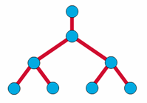
Network Topologies—Tree
The tree topology uses a trunk node from which it branches to other nodes.
binary tree (each node splits into two links)
backbone tree (a backbone trunk has branch nodes with links hanging from it).
Physical Perspective The trunk is a wire that has several layers of branches.
Logical Perspective The flow of information is hierarchical.
Notes:
数据交换在上下点之间，同层结点一般不交换数据。适用于数据汇集

Slide 63
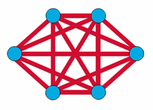
Network Topologies—
Complete (Mesh)
Physical Perspective
has distinct advantages and disadvantages
Advantage: the maximum connectivity and reliability.
Disadvantage: the amount of media for the links, and the amount of connections to the links becomes overwhelming.
Logical Perspective
The behavior of a complete, or mesh topology depends greatly on the devices used.
Notes:
广域网的实际结构。伴有路由选择算法与流量控制方法

Slide 64

Network Topologies—Cellular
Physical Perspective
The cellular topology is for wireless technology
Sometimes the receiving nodes move (e.g. cell phone), and sometimes the sending nodes move (e.g. satellite)
Logical Perspective
Nodes communicate with each other directly (though sometimes extremely difficult), or communicate only with their adjacent cells, which is extremely inefficient.
Notes:
Adhoc

Slide 65
Computer Network & Reference Model
Overview of Computer Network
OSI Reference Model
TCP/IP Model
Network Topology
Network Devices

Slide 66
LAN Devices in a Topology
Hosts—devices connected directly to network segment
printers, computers, servers, FAX, copier
Hosts—not part of any layer, but the functions of the OSI model are performed in software inside host

Slide 67
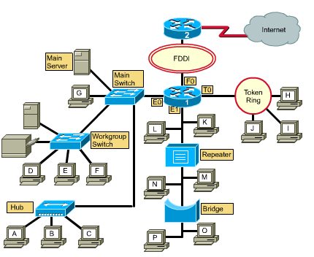
LAN Devices in a Topology

Slide 68
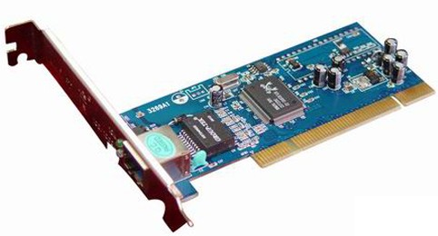
NICs – Layer 2
Carries a unique code called a MAC address
Is used to control data communication for the host on the network
Translates parallel signal produced by computer into serial format to send over the network
Transceiver used to convert signals as well as send and receive bits
IP 地址
硬件地址
计算机
CPU 和
存储器
适配器
（网卡）
至局域网
串行通信
并行
通信
生成发送的数据
处理收到的数据
把帧发送到局域网
从局域网接收帧
Provides the host’s access to the medium

Slide 69
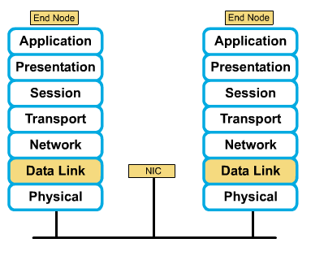
NICs – Layer 2

Slide 70
Media – Layer 1
Carries a flow of information in bits
The means by which signals travel from one networked device to another

Slide 71
Repeaters – Layer 1
used to extend the length of the network
clean, amplify, and resend signals that are weakened by long cable
regenerate (amplify) and retime network signals at the bit level to allow them to travel a longer distance on the media
perform no filtering

Slide 72
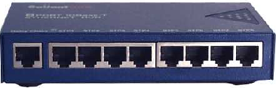
Hubs – Layer 1
used to regenerate and retime network signals
propagate signals
cannot filter traffic
cannot determine the best path
used as network concentration points
sometimes called multiport repeaters

Slide 73
Repeaters/Hubs - Differences
Repeater typically has only two ports and a hub generally has from four to twenty or more ports.
Repeater receives on one port and repeats on the other, while hubs receive on one port and transmit on all other ports.
Hubs most commonly found in Ethernet 10Base T or 100Base T networks.
Notes:
集线器是一种简单的设备，不具备解码网络主机之间所发送消息的电子元器件。它无法确定哪台主机应获取特定的消息。一个集线器只从一个端口接受电子信号，然后在所有其它端口重新生成（或重复）同一消息并发出。
以太网集线器的所有端口都连接到同一通道上发送和接收消息。由于所有主机都必须共享该通道可用的带宽，因此集线器被称为带宽共享设备。

Slide 74
Hub
Notes:
冲突会造成消息损坏，无法为主机所理解。集线器不会对消息进行解码，因此无法检测到消息是否已损坏，于是它在所有端口重复该消息并发出。主机可以接收因冲突而损坏的消息的网络区域称为冲突域。
当主机收到损坏的消息时，就会检测到发生了冲突。每台发送主机都会等待较短时间，然后再次尝试发送或重新传输该消息。当连接到集线器的主机数量增加时，冲突的概率也会增大。冲突越多，重新传输的次数也越多。过多的重新传输会阻塞网络，降低网络通信速度。因此，必须限制冲突域的大小。

Slide 75
Bridges – Layer 2
purpose is to filter traffic on a LAN—to keep traffic local—yet allow connectivity to other segments of the LAN for traffic that is directed there
keep track of MAC addresses that are on each side of the bridge and make decisions based on this MAC address list
more intelligent than hubs
collect and pass packets between segments
create collision domains
maintain address tables

Slide 77
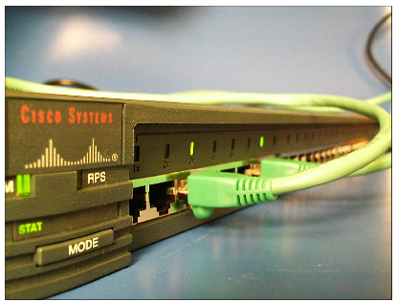
Switches – Layer 2
used to concentrate connectivity
combine the connectivity of a hub with the traffic regulation of a bridge
switch frames from incoming ports to outgoing ports providing each port with full bandwidth
provide separate data paths
Notes:
当一台主机发送消息到交换机上的另一台主机时，交换机将接受并解码帧，以读取消息的物理 (MAC) 地址部分。
交换机上含有一个 MAC 地址表，其中列出了包含所有活动端口以及与交换机相连主机的 MAC 地址。当消息在主机之间发送时，交换机将检查该表中是否存在目的 MAC 地址。如果存在，交换机就会在源端口与目的端口之间创建一个临时连接，称为电路。这一新电路为两台主机的通信提供一个专用通道。
如果目的 MAC 地址不在表中，交换机就没有创建电路所需的信息。当交换机无法确定目的主机的位置时，就会采用“泛洪”处理方式将消息转发到所有连接的主机。
新主机的 MAC 地址如何进入 MAC 地址表？交换机检查主机之间发送的每个帧的源 MAC 地址，然后创建 MAC 地址表。当新主机发送消息或响应“泛洪”式消息时，交换机就会立即获取其 MAC 地址及其连接的端口。交换机每次读取新的源 MAC 地址时，地址表都会自动更新。

Slide 78
Routers – Layer 3
important traffic-regulating device in large networks
Make decisions based on network addresses
examine packets (Layer 3 data), choose the best path for them, and then switch them out the proper outgoing port
two primary purposes: path selection and switching of packets to best route
Notes:
广播消息

Slide 79
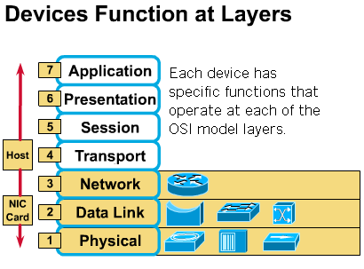
Evolution of Networking Devices and the OSI Layers

Slide 80


谢 谢！

